Slide 1
Quality of Life Data Analysis
EDA COURSE PROJECT
ON
Guided by:
Sunita Hiremath
Neha T
TEAM 05
Neeraj NK 01FE20BCS134 312
Anoop Patil 01FE20BCS138 315
Shreyas Joshi 01FE20BCS145 322
Kiran Patil 01FE20BCS151 328

Slide 2
Content
Problem Statement
Data Description
Understanding the domain
Insights on patient details
Pre Processing
Domain wise Analysis
Category wise Analysis
Conclusion

Slide 3
Problem statement
Measuring the quality of life of each patient of rehabilitation centre and analyzing their responses for WHOQOL- BREF questionnaire .Then concluding the QOL status of each patient by analyzing relevant attributes.

Slide 4
Data Description
The data set contains of 86 patient details collected from a rehabilitation centre.
To analyze the QOL of Individuals, WHO Prepared a Questionnaire Comprising 100 questions to get all information that is required to calculate QOL,Usually Questions are related to Physical health, social Relationship, Psychological ,and environmental Conditions of Each Indvidual.
BREF is a Shorter Counterpart version ,Which contains 26 questions.
Responses to this 26 questions are on a (1-5) Likert scale.
These 26 questions are further divided into 4 domains :
1) Physical health(Q-3,4,10,15,16,17,18)
2) Psychological (Q-5,6,7,11,19,26)
3) Social relationship (Q-20,21,22)
4) Environment(Q-8,9,12,13,14,23,24,25)
Questions 1 and 2 don’t belong to any of the domains.
D:\KLE\4th Sem\Data Mining and Analytics\EDA_Project\WHOQOL-BREF and Scoring Instructions (1).pdf

Slide 5
UNDERSTANDING THE DOMAINS :
1.Physical Health – 7 Questions
Includes Questions Related mobility, daily activities, functional capacity, energy, pain, and sleep.
2. Psychological – 6 Questions
The psychological domain measures include self-image, negative thoughts, positive attitudes, self-esteem, mentality, learning ability, memory concentration, religion, and the mental status.
3.Social relationship– 3 Questions
The social relationships domain contains questions on personal relationships, social support, and sex life.
4.Environmental– 8 Questions
Questions related to financial resources, safety, living physical environment, opportunities to acquire new skills and knowledge, recreation, general environment (noise, air pollution, etc.), and transportation

Slide 6
Patient Attributes
Description | Related attribites
Basic information about patient | Age,Sex,Education,Occupation
Usage of alcohol | Age when started drinking alcohol,Duration of execessive use of alcohol,Average units used in last 30 days,Alcohol type
Medical Information | Sugar(mg), Other Issues, Withdrawal symptoms experienced when the patient stopped, Medical Problem experienced(Past ), Medical Problem experienced(Present), Chronic health problem,Psychiatric complication_Past, Psychiatric complication_Present, History of previous head injureies, if any , Knowledge of allergy to specific drugs(if known)
Impression of the camp officer regarding the patient | impression of Camp officer about the patient, Denial of substance use-related problems, Motivation factor, Willingness for treatment, Action Taken
Work related status of patient | Specify nature of current work, At what age did you start working, How long have you been working, Have you received any special award

Slide 7
Patient Attributes
Description | Related attributes
Description of patient | Weight while admission (In Kg), Weight while discharge (In Kg), Height(In Ft)
Other habits | Use of Nicotine,Smoking,Other issues
Medical history of patients family | Family history of alcoholism / drug abuse, if any (who and which type of drug), If any SpecV, Family history of psychiatric illness in family, if any specify (who),
Past treatment for alcoholism | Past deaddiction treatments received/not, Name of the Hospital/ Deaddiction Center, year of Treated, Period of Treatment, Period of sober, Remarks
Family members (father, mother, sisters, brothers, wife, children) status | Living: Age, State Of Health Dead: Year of Death, Cause Of Death, Patient age at death

Slide 8
Patient Attributes
Description | Related attributes
Legal details of patient | Details of Debts to be cleared, Legal complications
Childhood impact affecting currently | Behaviour problem identified in Childhood,Family history, Describe your childhood / teenage year, Religious beliefs
Educational Information of patient | Achievements in the Education, year of Education, High achiever in extracurricular activities
Sexual status of the patient | If unmarried, premarital sexual encounters, Record extra marital experiences, Have you involved in any high risk sexual activities, At present do you have any sexual problem
Marital history D:\KLE\4th Sem\Data Mining and Analytics\170-VIP-Camp-Patient-Details3.csv | Name, Age, religion, education, occupation, monthly income, Arranged Marriage/Love marriage, Number of year of marriage, multiple marriages, Have you been separated from your spouse due to your addiction, Are you suspicious of your wife, any instance of family violence

Slide 9
Few Insights About Patient’s Data :
67% of patients are Married and 33% are unmarried.
Many of them Started Drinking at Early Age.
Majority of them belong are of 31 to 40.
Majority of patients are in agriculture.
Calculating risk level based on ethanol content and type of alcohol we got to know that 12 are in high and 42 are under low risk and 32 are in medium risk level.

Slide 10
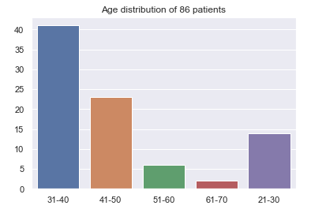
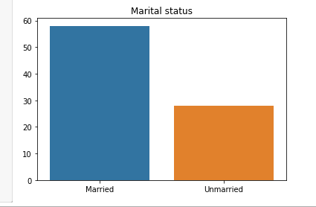
Few Insights About Patient’s Data :
All 86 patients are male and their age ranges from 24 to 64.

Slide 11
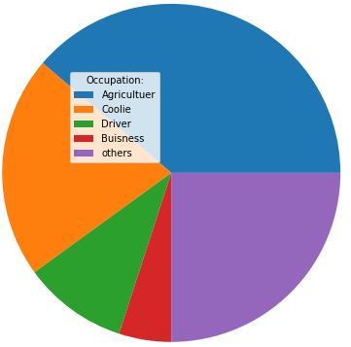
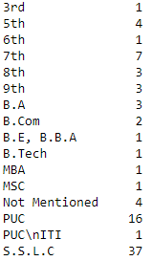
Few Insights About Patient’s Data :

Slide 12
PRE- PROCESSING of DATA
Cleaning the Data
The Original Dataset we Obtained Earlier had 108 Attributes.
But After Pre-Processing We reduced down to 48 Attributes by
Eliminating Columns which Containing Mostly Null Values
& DSM-5 Columns Deleted as They are Not Required for Our Analysis.
Ex: Rligious beliefs and behaviourQn 1
Columns Containing Fewer Null Values ,Got Replaced by Mode or “Not Mentioned “ Status .
Ex: Quantity/day of Smoking.
Few Columns are Ignored ,Because Mostly the Input Values are Same by All Patients,Hence they are Not Much Useful for our Analysis.
Ex : Willingness for Treatment etc.
Columns with Irrelevant Attributes are also Eliminated.
Ex: Assessment Date , Sister’s Living age etc.

Slide 13
Few Columns have Values of type ‘Object’, So We Converted Such Columns to String.
Certain Values Indicates Same Meaning,But Still Words are Misplaced Slightly
So We Pre-Processed such Values by Verifying Manually.
Bringing Values of Same column to Single Unit.
Ex : duration of excessive use of alcohol(in years)
Converted Days ,Months into Years.

Slide 14

Adding required rows to dataframe
The Obtained Data Set Containing Scores of Each Patient for 24 Questions Belonging to 4 Different Domains.
A Raw Score Column is Added to Dataframe by Summation of their Scores.
But There is Need of Transformed Score to add meaning to the scores and allows some kind of interpretation of the scores.
It allows direct comparison of two scores. For example, a score of 33 on the first test might not mean the same thing as a score of 33 on the second test. So we Added Tranformed Score Table (Ranging 0-100)
to Dataframe by Using Following Formula.

Slide 15
Target Variable : Verdict(QOL Status)
A Verdict Containing Categorical Data , Decides the QOL Status of Each Patient by the Help of their Transformed Scores. Which will be Added to Dataframe for Further Analysis.
Transformed Score | Verdict
0 - 20 | Very Poor
21 - 40 | Poor
41 - 60 | Neither Poor Nor Good
61 - 80 | Good
81 - 100 | Very Good

Slide 16
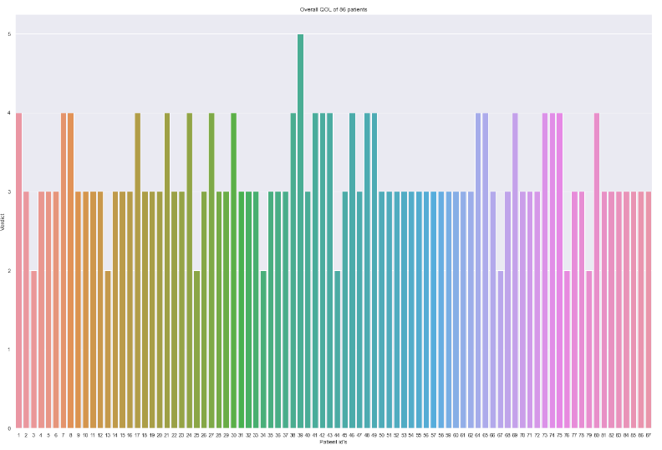
can we classify the patients based on QOL?

Slide 17

QOL Status
From the above graph we can observe that majority of patients lie in neither poor nor good QOL status and hence the overall QOL of all 86 patients is also the same.
There is one outlier with QOL status 5(very good).
The average QOL of all patients is 53.94(which is neither poor nor good).
Analysing QOL of 86 patients considering all domains in which QOL status they fall?
QOL Status Count

Slide 18
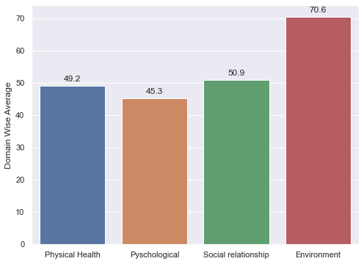
Domain wise average of all patients

Slide 19
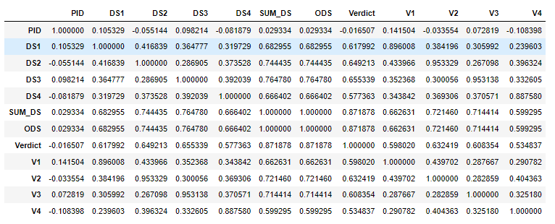
How is the relation between domains and verdict(class label)?

Slide 20
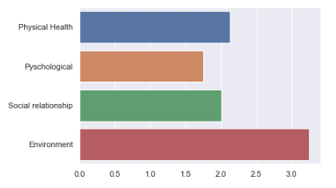
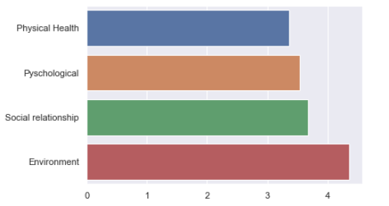
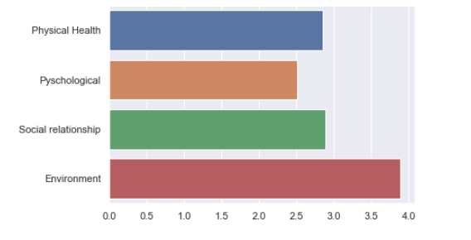
QOL status: Poor QOL status: Good
QOL status: Neither poor nor good

Slide 21
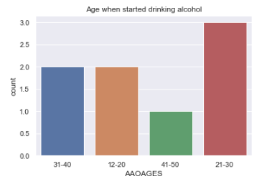
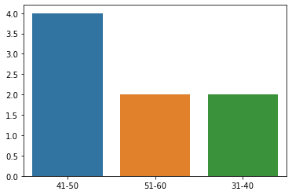
Patients analysis with QOL status poor
There are 8 patients with QOL status poor out of 86 i.e around 10%.
Age distribution of 8 patients.

Slide 22

Patients analysis with QOL status poor
There are 8 patients with QOL status poor.
Out of which 7 are married and 1 is unmarried.
Many of the patients started drinking at a young age fact that their present age is above 31 and hence the period for which they consumed alcohol is more i.e 15.375 years on average.
75% of them started working in young age.
Out of 8 patients, we can observe that all of them are above age of 41.
The majority of them were influenced by their family.

Slide 23
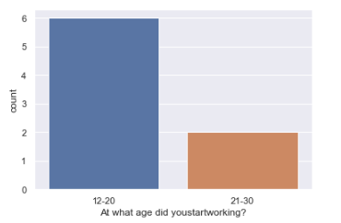
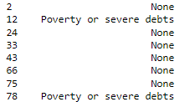



Slide 24
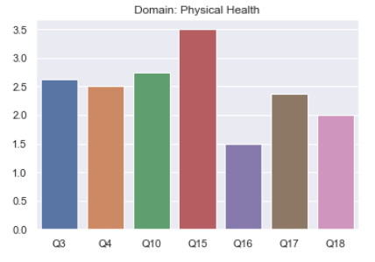
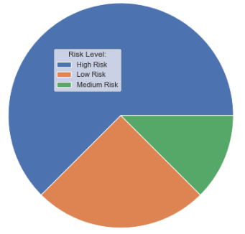
Patients analysis with QOL status poor

Slide 25
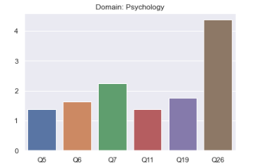
Patients analysis with QOL status poor
It is observed that some of the patients have childhood problems of running away from home and scholastic backwardness.
Also 38% of them have problem of confussion sggressive outburst and depression.

Slide 26
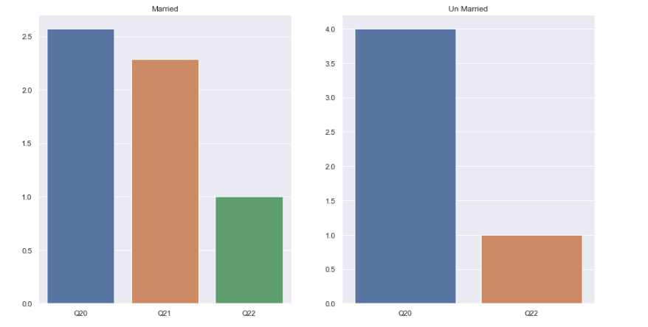
Patients analysis with QOL status poor
Out of 8 patients 7 are married and 1 is unmarried and both don’t get support from friend and hence Q22 has least response.

Slide 27
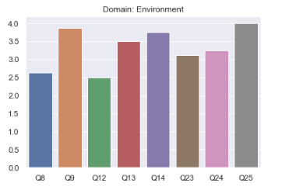
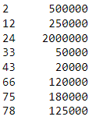
Patients analysis with QOL status poor
Q12 has less response which about does they have enough money to meet their needs as all of them have debts.

Slide 28
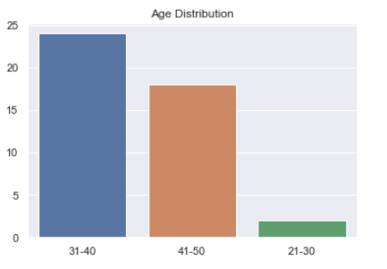
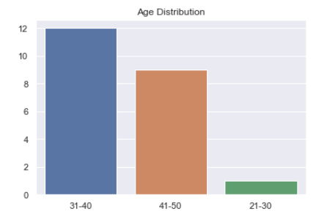
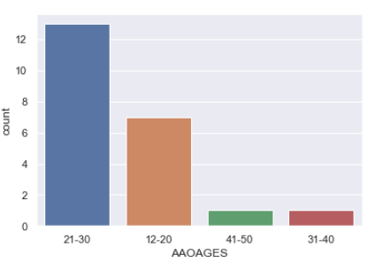
Patients analysis with QOL status Good
PID’s of patient
1,7,8,17,21,24,27,30,38,41,42,43,46,48,49,64,65,69,73,74,75,80
Out of 22 patients, we can observe that all of them are above age of 21 and under the age 40.
Of which 50% of patients have education only till 10th grade.
All of the patients started drinking in middle age hence consumed alcohol quantity is less than patients with poor QOL and NPG i.e 13.31 years on average.

Slide 29
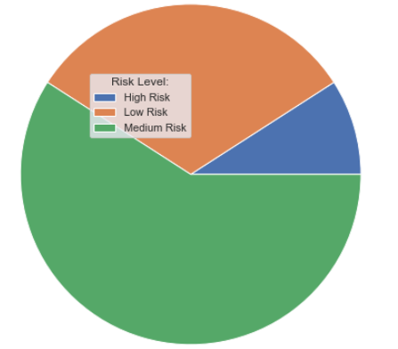
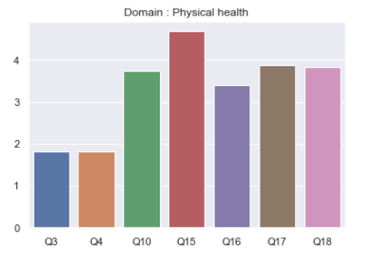
Patients analysis with QOL status Good
Physical health: Good
Psychology: Good
Social relationship: Good
Environment: Very good
Q15) How well are you able to get around?
As nobody of them have any chronic health problems.
Q16)60% of patients have medium risk.

Slide 30
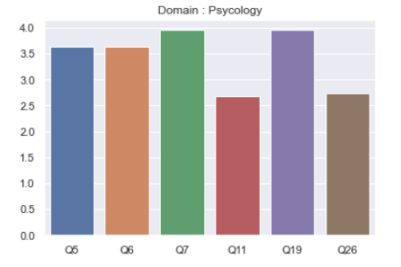
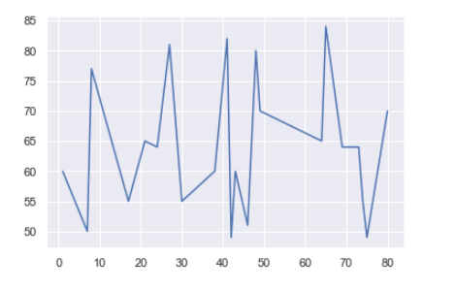
Patients analysis with QOL status Good
Q11)Are you able to accept your bodily appearance?
Q26)How often do you have negative feelings, such as blue mood, despair, anxiety, depression?
13% of patients have psychiatrist complication

Slide 31
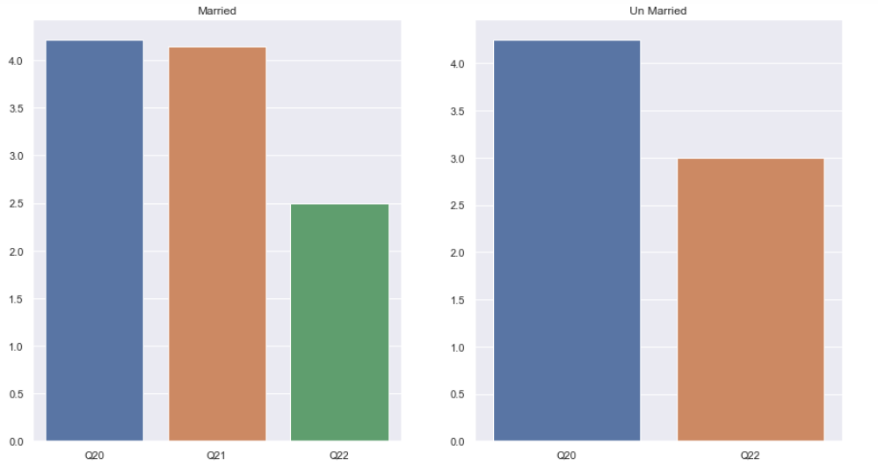
Patients analysis with QOL status Good
Out of 22 patients are 14 married and 8 is unmarried and both don’t get support from friend hence Q22 has the least response.

Slide 32
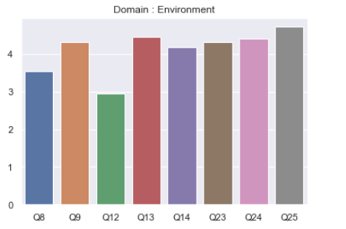
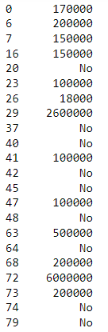
Patients analysis with QOL status Good
Q12) Have you enough money to meet your needs?

Slide 33
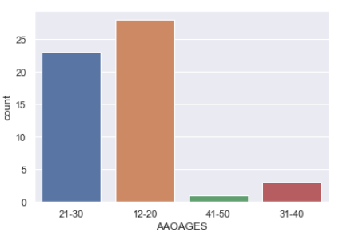
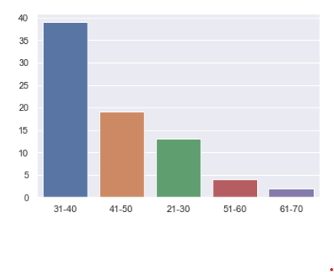
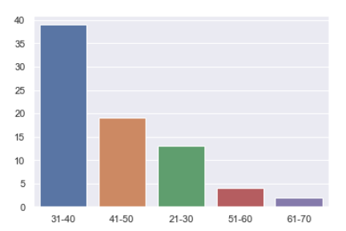
Patients analysis with QOL status neither poor nor good
The majority of the patients started drinking in middle age.
Out of 55 patients, we can observe that all of them are above age of 21 and under the age 70.
And 70% of them have only education till 10th.
All of the patients started drinking in young and middle age hence consumed alcohol quantity is less than patients with poor QOL and more NPG i.e 13.74 years on average.

Slide 34
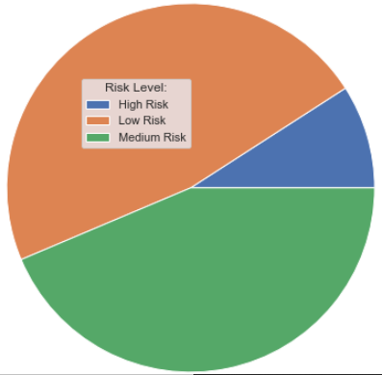
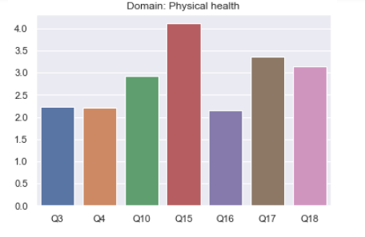
Patients analysis with QOL status neither poor nor good
Many of the patients have medium risk.

Slide 35
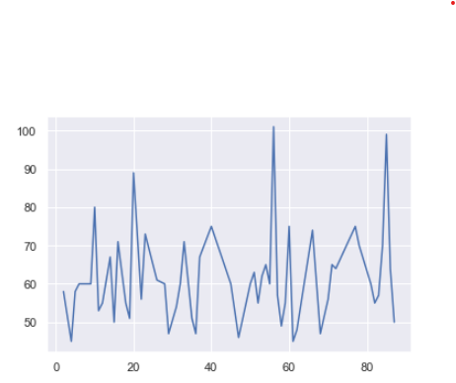
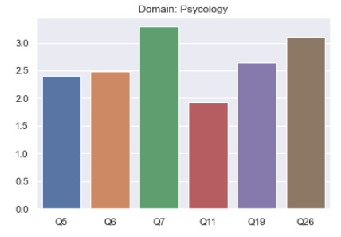
Patients analysis with QOL status neither poor nor good
Q26) 26. How often do you have negative feelings, such as blue mood, despair, anxiety, depression?
18% patients have psychiatric complications.

Slide 36
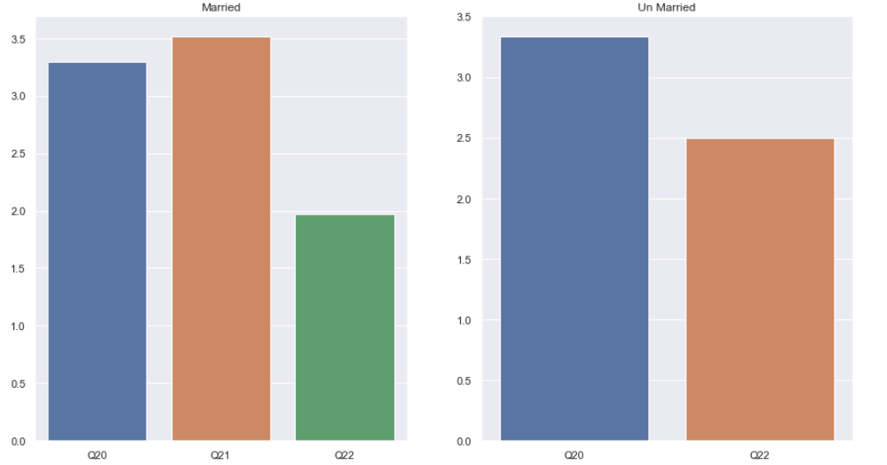
Patients analysis with QOL status neither poor nor good
Out of 55 patients are 37 married and 18 is unmarried and both don’t get support from friend hence Q22 has the least response.

Slide 37
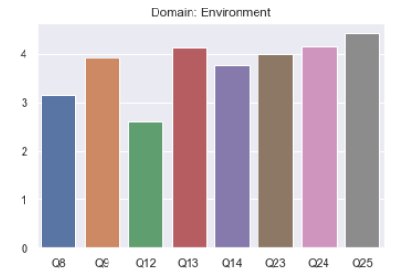
Patients analysis with QOL status neither poor nor good
Q12) Have you enough money to meet your needs?
50% of patients have debts.

Slide 38
Conclusion
Class label | Psychiatric complications | Stressors | Average alcohol consumption(in years | Withdrawal symptoms | Medical Problem experienced | If any SpecV
Poor | 38% | 50% | 15.37 | 75% | 12.5% | 25%
Neither poor nor good | 18% | 38.18% | 13.74 | 80% | 20% | 41%
Good | 15% | 36.36% | 13.31 | 63% | 10% | 50%
Most of them have debts.
On average QOL of married patients is 53 whereas that of unmarried is 56.

Slide 39
Thank you

